Slide 1
Interaction Design Lecture 3

Slide 2
Human Action Cycle
This builds on the concept of tasks, actions, and goals
The human action cycle is a psychological model that describes the steps users take when they interact with computer systems.
In particular, the cycle shows the way users perform actions and tasks to achieve their goals.

Slide 3
Human Action Cycle
The user activities in the human action cycle are:
Forms a goal
Creates and executes actions that move toward that goal
Perceives and interprets the outcome of executing the actions to see whether the goal will be achieved.
Recognizes that if the goal cannot be achieved, it may have to be reformulated and the cycle repeated
Thus, the human action cycle involves both cognitive and physical activities.

Slide 4
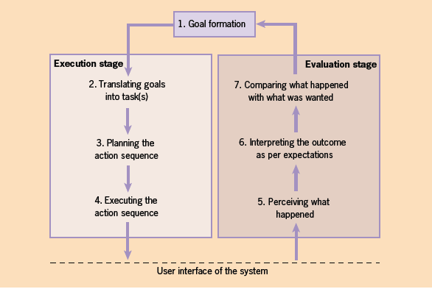
Human Action Cycle

Slide 5
Human Action Cycle
Three main stages in the cycle
1. Goal formation, this constitutes step one, which is a cognitive activity.
2. Execution stage, during this , the users perform both cognitive and physical activities.
- Cognitive activities include translating the goals into tasks and planning the action sequences.
- Whereas physical activities involve executing the sequences of actions.
3. Evaluation stage, all steps in this stage are cognitive activities .

Slide 6
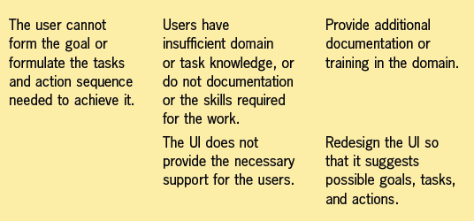
Solutions to Problems During HAC
1

Slide 7
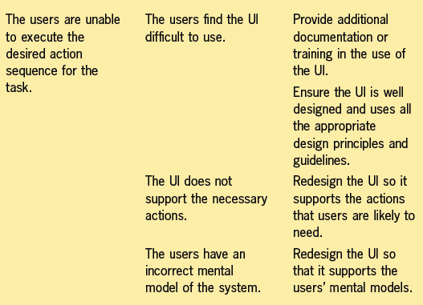
Solutions to Problems During HAC
2

Slide 8
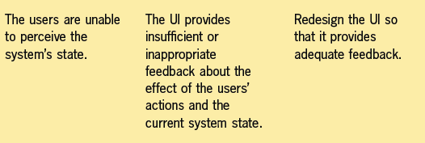
Solutions to Problems During HAC
3

Slide 9
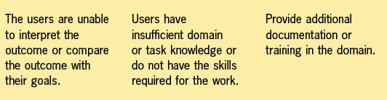
Solutions to Problems During HAC
4

Slide 10
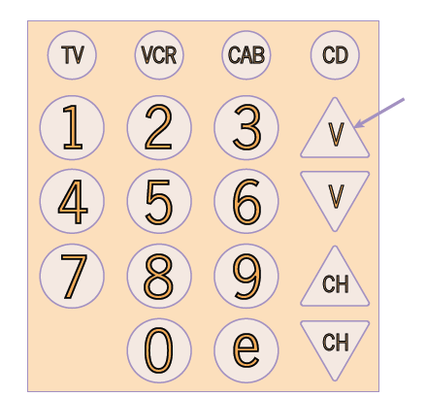
Lowering the volume on a TV.
The buttons are shaped like up and down arrows for increasing and decreasing the volume
A user will push the button indicated by the arrow. This will increase the volume.
Instead of the large V on the volume-control buttons, “vol” in smaller letters could be used as a label.
A control’s features such as placement, labeling, size, and color need to work together to show how to use the control.

Slide 11
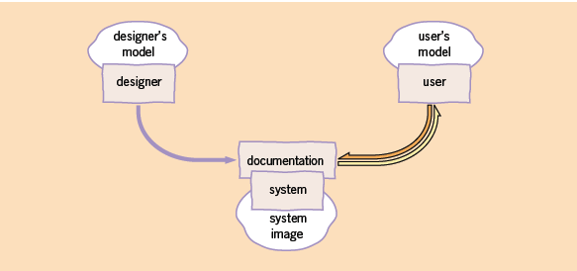
Designer, User, System image
To interact effectively with a UI, an accurate model of its behavior is needed (Mental Model).

Slide 12
Designer, User, System image
Three elements:
The designer’s model. It includes both the structural and functional aspects of the system —both how it works and how to operate it.
The designer’s model is usually complete and correct.
2. The user’s model. It contains mainly functional information, possibly incomplete and incorrect.
3. The system image. This includes the UI, supporting documentation, training, and so on.
The purpose of the system image is to communicate enough of the designer’s model to the users so that they can create an accurate mental model of the system.

Slide 13
Designer’s model
The designer’s model is an explicit and consciously developed model, derived from:
• The structure and organization of the UI.
• An understanding of the domain and the system’s purpose and Functionality.
• An understanding of users’ requirements, their characteristics, tasks, and expectations of the new system.
• The system’s technology and the environment
• Any hardware platform or implementation constraints

Slide 14
Users’s model
To take into account the user’s model, you need to consider a number of design issues:
• Matching the users’ expectations
More understandable and easier to learn.
• Shaping the user’s model
Familiar functions are easy to pick out
• Flexibility
Typically, the user’s model is not static but grows through interaction with the UI. Since user’s models change with time, the designer should create a flexible UI —for example, providing different ways of accomplishing the same tasks to suit both novices and experiences

Slide 15
Metaphors
A figure of speech in which a word or phrase denoting one kind of object or action is used in place of another to suggest a likeness or analogy between them.
There is a sense in which everything generated by a computer is metaphorical.
Probably the best-known example of this is Microsoft Windows:
1. Words on the screen, such as screen titles and labels
2. Static images and icons, such as the printer icon in Word
3. Interactive graphics, such as the calculator that comes with Windows

Slide 16
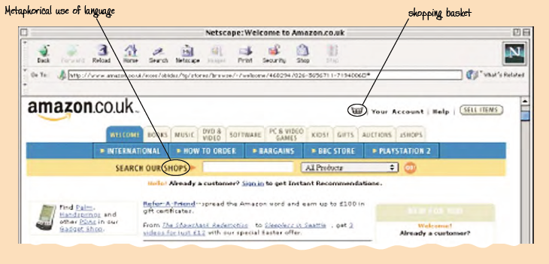
Metaphors

Slide 17
Benefits of Metaphor
Metaphors are often used to unify UI.
Enables the user to develop a more accurate mental model of the UI
Problems with Metaphor
Unfortunately, it is not that simple.
Two important classes of problem that can arise when using metaphors.

Slide 18
Problems with Metaphor
1
Metaphors That Do Not Match the Users’ Experience of the World
For example,
The Windows calculator can be changed from a conventional calculator to a scientific calculator. Although this is unexpected, it is extremely useful.

Slide 19
Problems with Metaphor
2
Metaphors That Relate to Objects or Concepts That Are Outside the
User’s Experience
There is no point in using a metaphor if the physical analogue is outside the user’s experience.

Slide 20
Summary
In this Lecture, we have considered a model of the interaction process known as the human action cycle, and we have discussed the use of mental models and metaphors for UI design.
In the next Lecture, we turn our attention to interaction styles, which are the different ways by which a user and computer system can interact.

Slide 21
THANKS

